Slide 1

Sentiment Analysis
CAPSTONE PROJECT
Presented By:
Banavasi Prakash
Srinivasa Ramanujan Institute Of
Technology(Autonomous)-Anantapur

Slide 2
OUTLINE
Problem Statement (Should not include solution)
Proposed statement/solution
System Development Approach (Technology Used)
Algorithm & Deployment
Result
Conclusion
Future Scope
References

Slide 3
Problem Statement
Example: Develop a Sentiment Analysis model to classify reviews as positive or negative . And preprocess the review text using techniques such as lower casing , removing stop words and Lemmatization . Use the trained model accurately predict the sentiment new , unseen reviews.

Slide 4
Proposed Solution
The proposed system aims to address the challenge of predicting the taking the reviews in the restaurant about the food from the customer which means taking the feed back from the customer. This involves leveraging data analytics and machine learning techniques to forecast demand patterns accurately. The solution will consist of the following components:
Data Collection:
Gather historical data in Restaurants about food, taking the feedback from the customer, and other relevant factors.
Utilize real-time data sources, such as online reviews ,social media , surveys and feedback, blogs and forms , to enhance prediction accuracy.
Data Preprocessing:
Clean and preprocess the collected data to handle missing values, outliers, and inconsistency
Machine Learning Algorithm:
Implement a machine learning algorithm, such as a Naive Bayes model (is used to detect the information for the process of training) , to take the feed back from the customer in Restaurant.
Consider incorporating other factors like online reviews ,social media and special events to improve prediction accuracy.

Slide 5
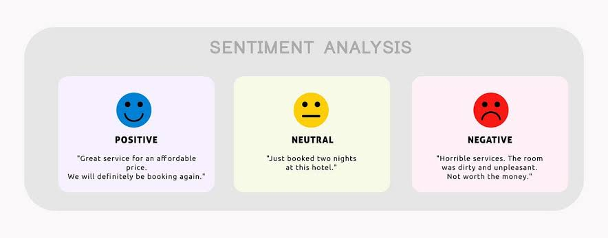
Deployment:
Develop a user-friendly interface or application that provides real-time predictions form customer about feedback takes at different hours in Restaurant.
Deploy the solution on a scalable and reliable platform, considering factors like social media, online reviews, and user accessibility.
Evaluation:
Assess the model's performance using appropriate metrics such as Naive Bayes, or other relevant metrics.
Fine-tune the model based on feedback and continuous monitoring of prediction accuracy.
Result:

Slide 6
System Approach
The "System Approach" section outlines the overall strategy and methodology for developing and implementing the feedback from the customer in the Restaurant. Here's a suggested structure for this section:
System requirements is used the combination of a language called NLP(Natural Language Processing)
And also use Machine learning algorithms to predict the output.
Library required to build the model:
The libraries used is NLTK, Pandas ,spaCY, Scikit-learn.

Slide 7
Algorithm & Deployment
In the Algorithm section, describe the machine learning algorithm chosen for knowing the feedback from customer Here's an example structure for this section:
Algorithm Selection:
Provide a brief overview of the chosen algorithm (e.g., Navie Bayes model) and justify its selection based on the problem statement and data characteristics.
Data Input:
Specify the input features used by the algorithm, such as historical data of restaurant food items, online reviews, social media and any other relevant factors.
Training Process:
Explain how the algorithm is trained using historical data. Highlight any specific considerations or techniques employed, such as cross-validation or hyperparameter tuning.
Prediction Process:
Detail how the trained algorithm makes predictions for feedback of customer in the Restaurant. Discuss any real-time data inputs considered during the prediction phase.

Slide 8
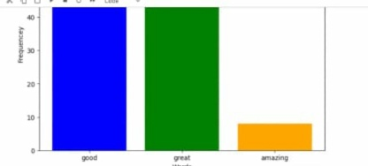
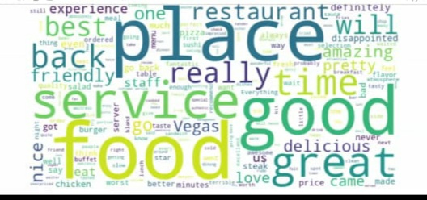
Result
Present the results of the machine learning model in terms of its accuracy and effectiveness in predicting feedback from the customer in Restaurant. Include visualizations and comparisons between predicted and actual counts to highlight the model's performance.

Slide 9
Conclusion
Summarize the findings and discuss the effectiveness of the proposed solution. Highlight any challenges encountered during the implementation and potential improvements. Our sentiment analysis of customer feedback for the Restaurant provides valuable insights into the overall customer experience By systematically analysing customer feedback , the Restaurant can make data driven decision to improve the service quality and enhance customer experience and business growth .

Slide 10
Future scope
Discuss potential enhancements and expansions for the system. This could include incorporating additional data sources, optimizing the algorithm for better performance, and expanding the system to cover multiple cities or regions. Consider the integration of emerging technologies such as edge computing or advanced machine learning techniques.

Slide 11
References
List and cite relevant sources, research papers, and articles that were instrumental in developing the proposed solution. This could include academic papers on customer reviews in restaurant, machine learning algorithms, social media, internet and best practices in data preprocessing and model evaluation.

Slide 12


